Slide 1
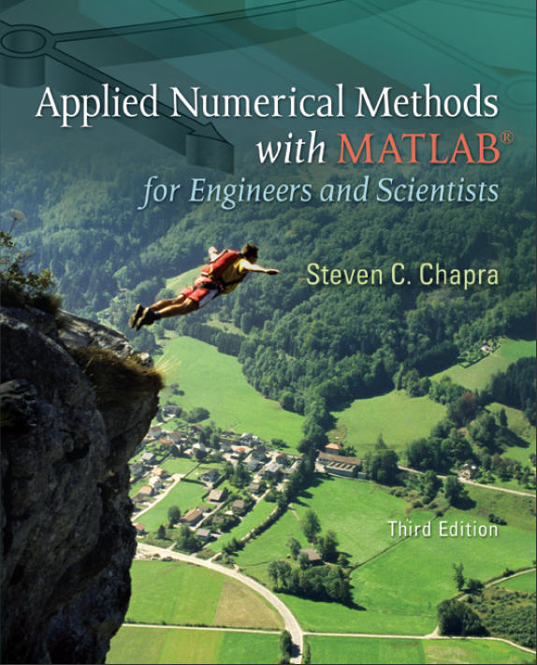
Part 5
Chapter 19
Numerical Integration Formulas
PowerPoints organized by Dr. Michael R. Gustafson II, Duke University
All images copyright © The McGraw-Hill Companies, Inc. Permission required for reproduction or display.

Slide 2
Chapter Objectives
Recognizing that Newton-Cotes integration formulas are based on the strategy of replacing a complicated function or tabulated data with a polynomial that is easy to integrate.
Knowing how to implement the following single application Newton-Cotes formulas:
  Trapezoidal rule
  Simpson’s 1/3 rule
  Simpson’s 3/8 rule
Knowing how to implement the following composite Newton-Cotes formulas:
  Trapezoidal rule
  Simpson’s 3/8 rule

Slide 3
Objectives (cont)
Recognizing that even-segment-odd-point formulas like Simpson’s 1/3 rule achieve higher than expected accuracy.
Knowing how to use the trapezoidal rule to integrate unequally spaced data.
Understanding the difference between open and closed integration formulas.

Slide 4
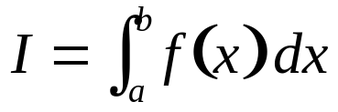
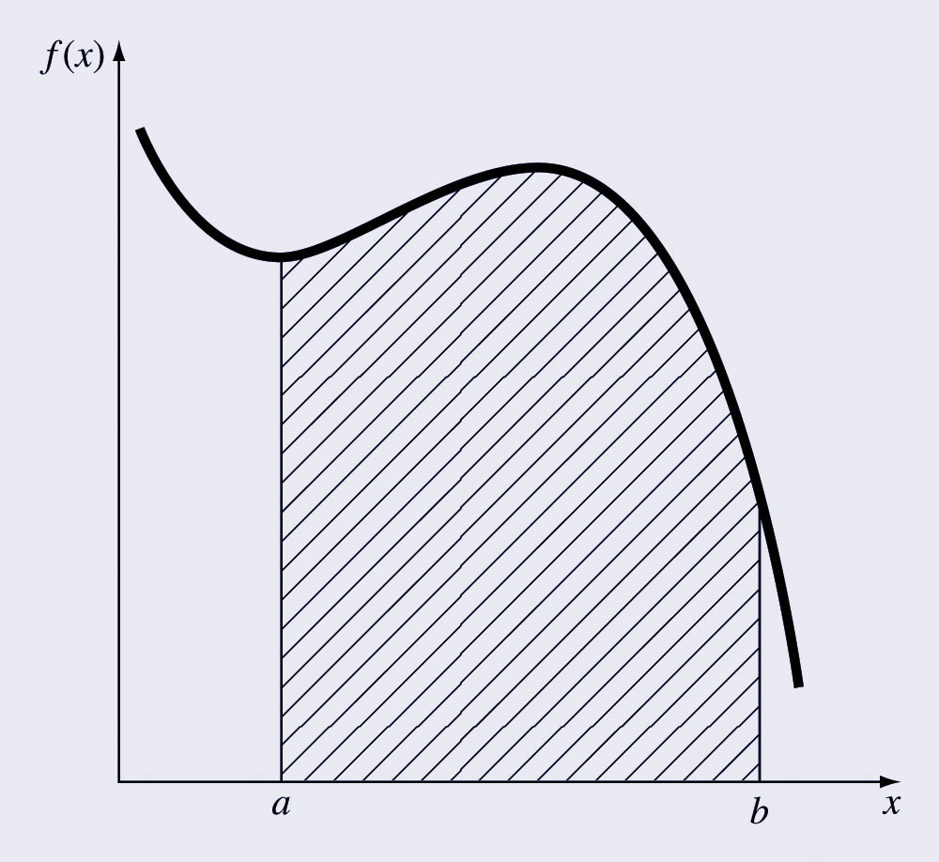
Integration
Integration:
is the total value, or summation, of f(x) dx over the range from a to b:

Slide 5
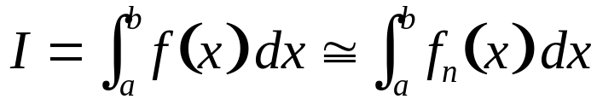
Newton-Cotes Formulas
The Newton-Cotes formulas are the most common numerical integration schemes.
Generally, they are based on replacing a complicated function or tabulated data with a polynomial that is easy to integrate:
where f_{n}(x) is an n^{th} order interpolating polynomial.

Slide 6
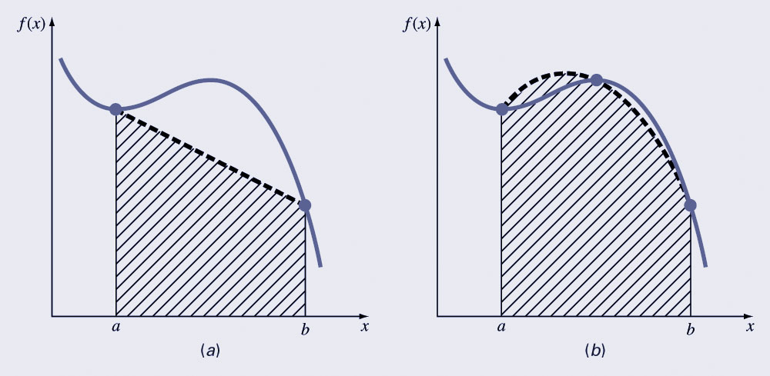
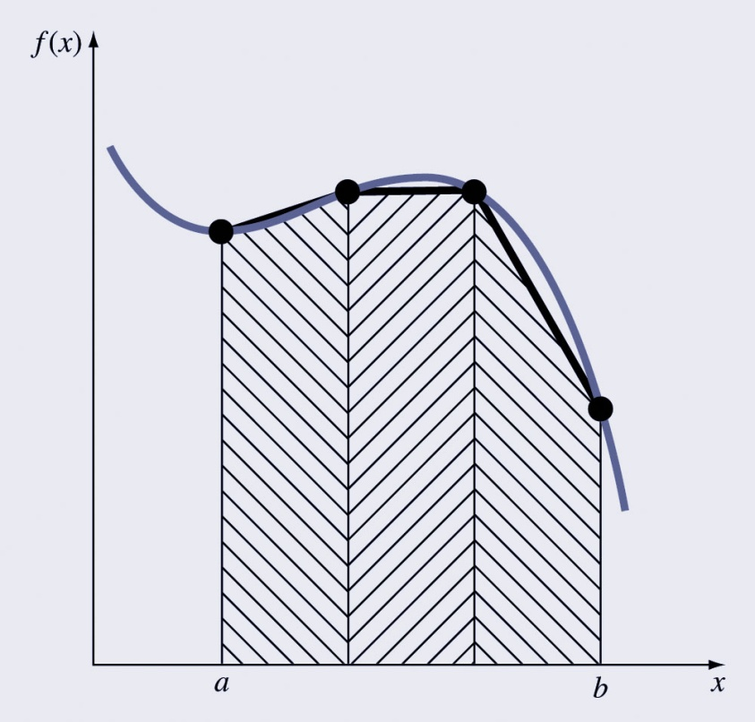
Newton-Cotes Examples
The integrating function can be polynomials for any order - for example, (a) straight lines or (b) parabolas.
The integral can be approximated in one step or in a series of steps to improve accuracy.

Slide 7
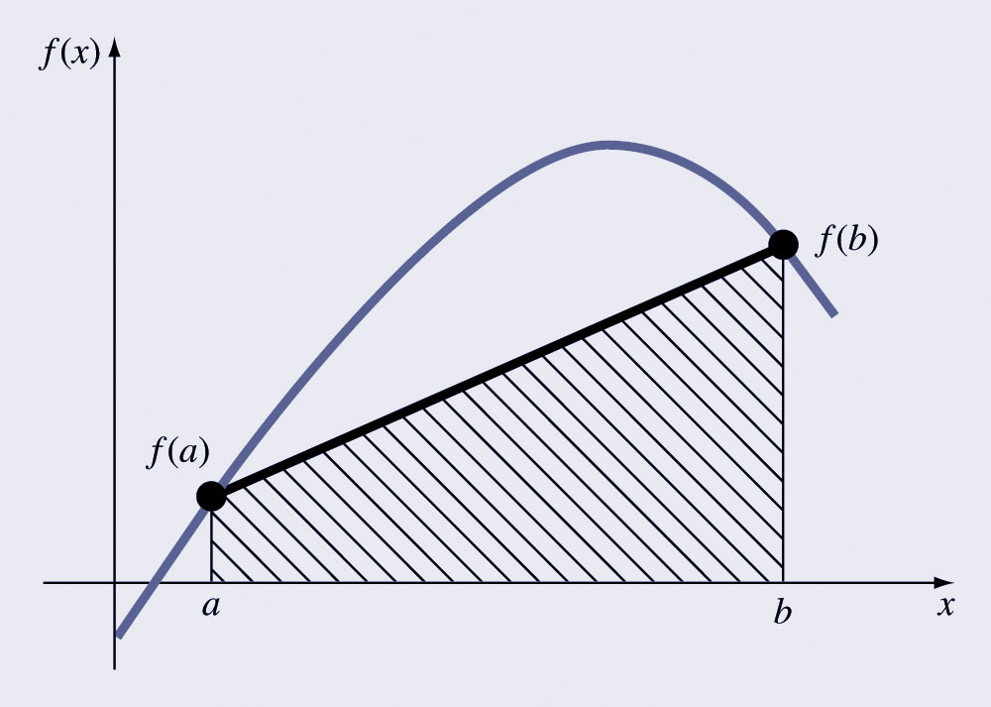
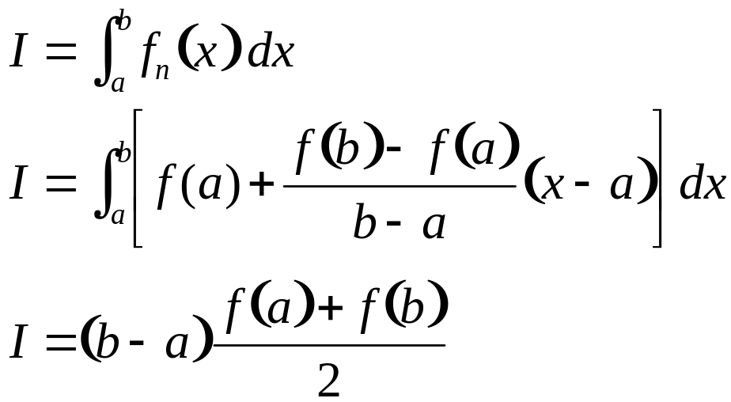
The Trapezoidal Rule
The trapezoidal rule is the first of the Newton-Cotes closed integration formulas; it uses a straight-line approximation for the function:

Slide 8
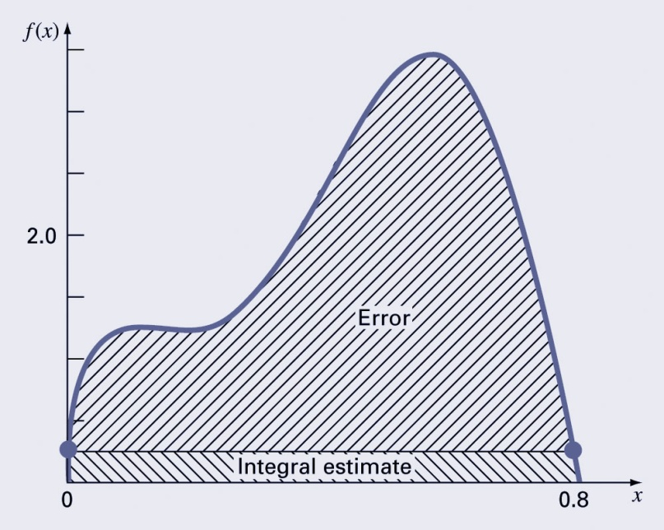
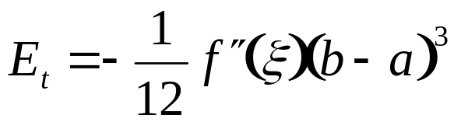
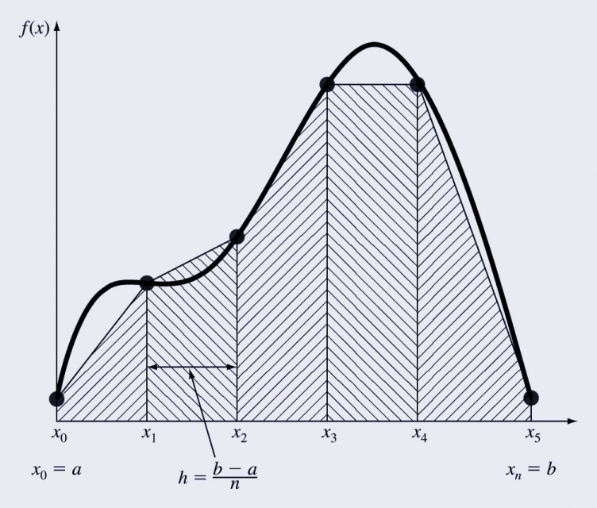
Error of the Trapezoidal Rule
An estimate for the local truncation error of a single application of the trapezoidal rule is:
where ξ is somewhere between a and b.
This formula indicates that the error is dependent upon the curvature of the actual function as well as the distance between the points.
Error can thus be reduced by breaking the curve into parts.

Slide 9
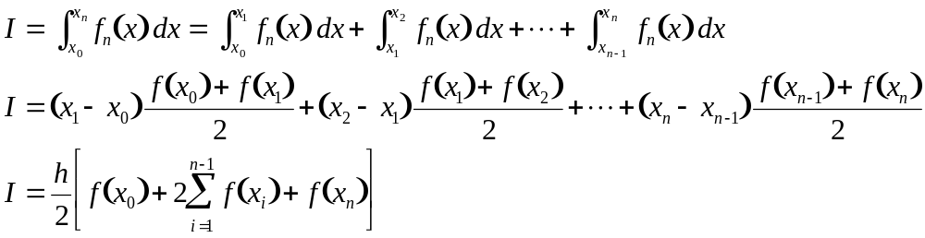
Composite Trapezoidal Rule
Assuming n+1 data points are evenly spaced, there will be n intervals over which to integrate.
The total integral can be calculated by integrating each subinterval and then adding them together:

Slide 10
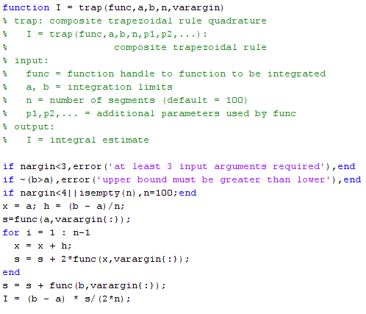
MATLAB Program

Slide 11
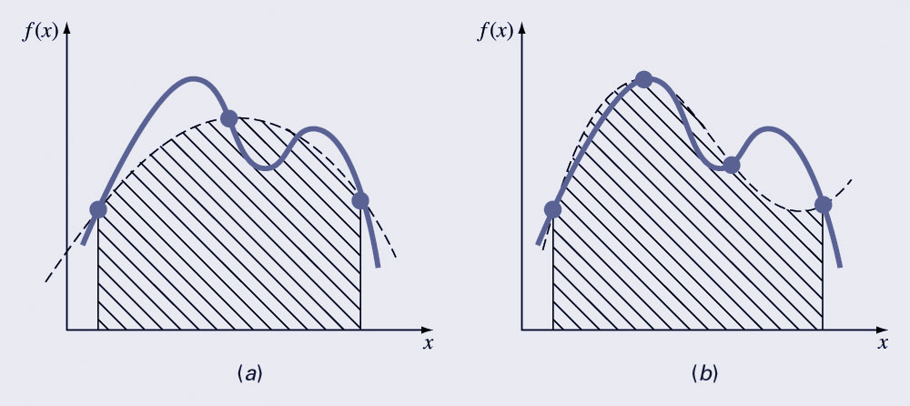
Simpson’s Rules
One drawback of the trapezoidal rule is that the error is related to the second derivative of the function.
More complicated approximation formulas can improve the accuracy for curves - these include using (a) 2nd and (b) 3rd order polynomials.
The formulas that result from taking the integrals under these polynomials are called Simpson’s rules.

Slide 12
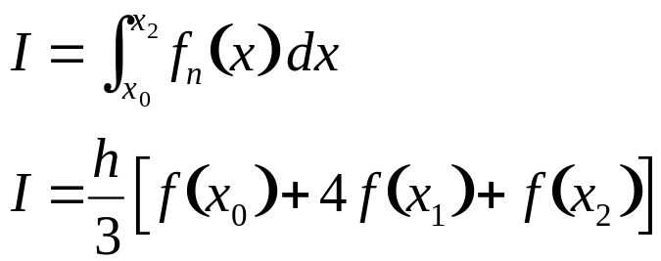
Simpson’s 1/3 Rule
Simpson’s 1/3 rule corresponds to using second-order polynomials. Using the Lagrange form for a quadratic fit of three points:
Integration over the three points simplifies to:

Slide 13
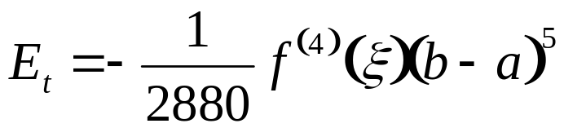
Error of Simpson’s 1/3 Rule
An estimate for the local truncation error of a single application of Simpson’s 1/3 rule is:
where again ξ is somewhere between a and b.
This formula indicates that the error is dependent upon the fourth-derivative of the actual function as well as the distance between the points.
Note that the error is dependent on the fifth power of the step size (rather than the third for the trapezoidal rule).
Error can thus be reduced by breaking the curve into parts.

Slide 14
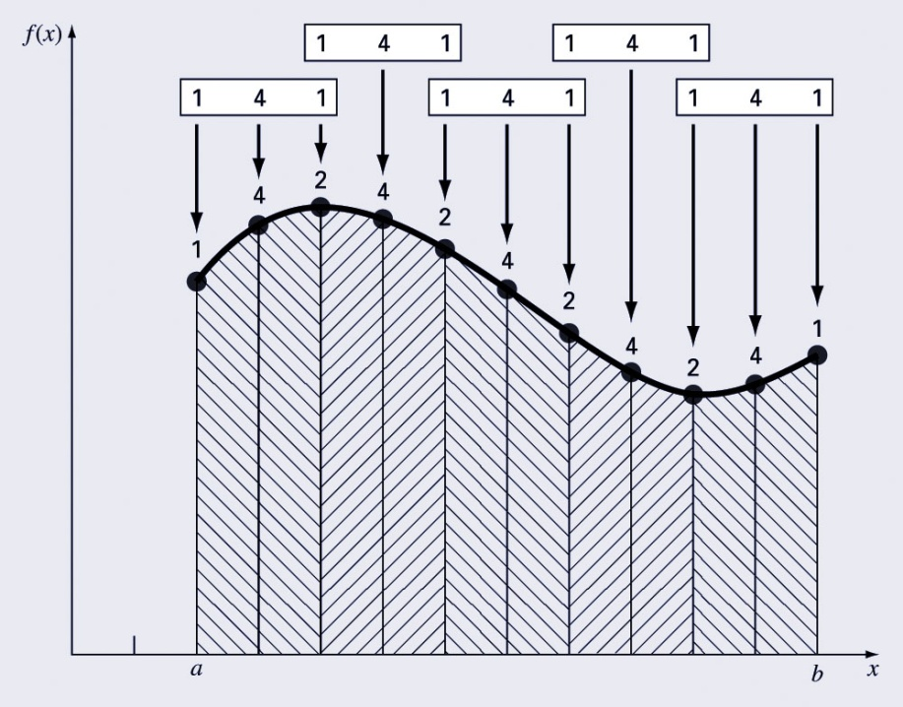
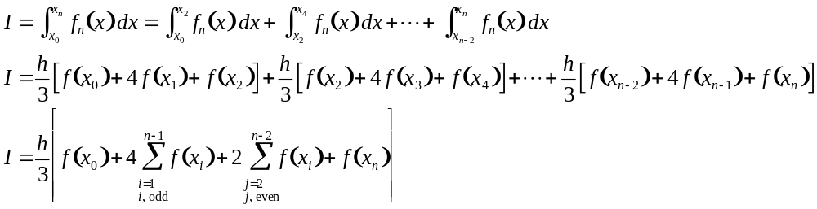
Composite Simpson’s 1/3 Rule
Simpson’s 1/3 rule can be used on a set of subintervals in much the same way the trapezoidal rule was, except there must be an odd number of points.
Because of the heavy weighting of the internal points, the formula is a little more complicated than for the trapezoidal rule:

Slide 15
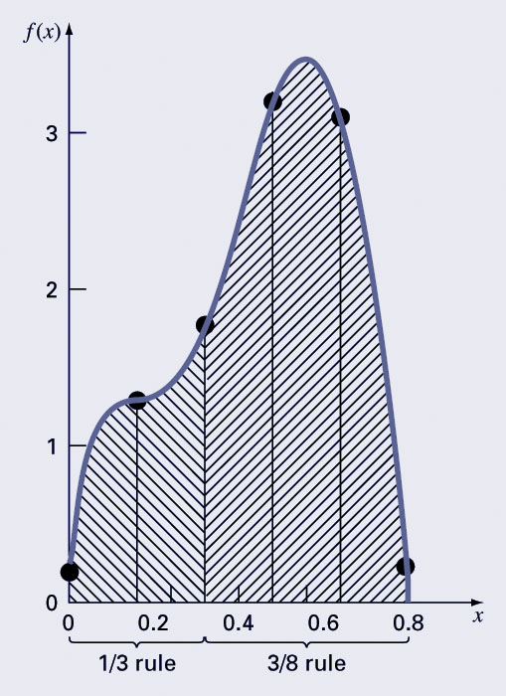
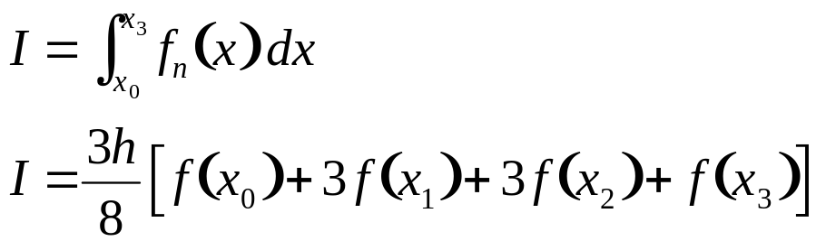
Simpson’s 3/8 Rule
Simpson’s 3/8 rule corresponds to using third-order polynomials to fit four points. Integration over the four points simplifies to:
Simpson’s 3/8 rule is generally used in concert with Simpson’s 1/3 rule when the number of segments is odd.

Slide 16
Higher-Order Formulas
Higher-order Newton-Cotes formulas may also be used - in general, the higher the order of the polynomial used, the higher the derivative of the function in the error estimate and the higher the power of the step size.
As in Simpson’s 1/3 and 3/8 rule, the even-segment-odd-point formulas have truncation errors that are the same order as formulas adding one more point. For this reason, the even-segment-odd-point formulas are usually the methods of preference.

Slide 17
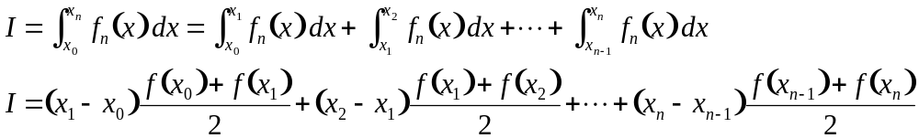
Integration with Unequal Segments
Previous formulas were simplified based on equispaced data points - though this is not always the case.
The trapezoidal rule may be used with data containing unequal segments:

Slide 18
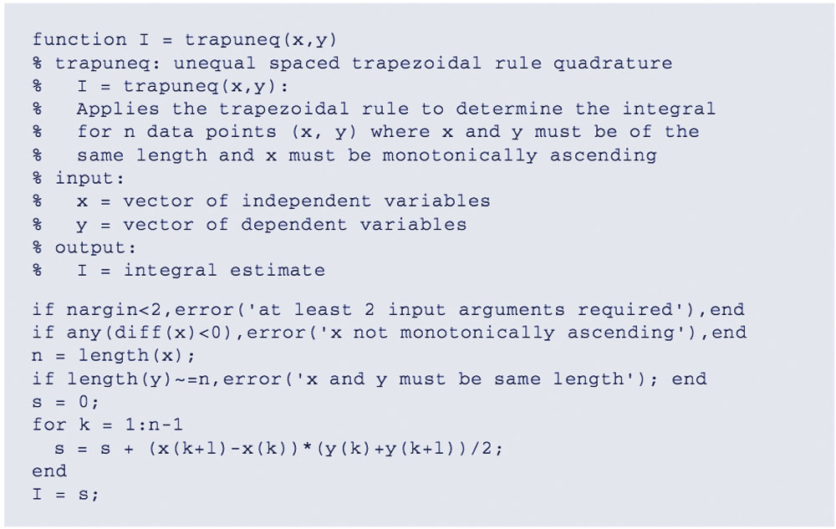
Integration Code for Unequal Segments

Slide 19
MATLAB Functions
MATLAB has built-in functions to evaluate integrals based on the trapezoidal rule
z = trapz(y)
z = trapz(x, y)
produces the integral of y with respect to x. If x is omitted, the program assumes h=1.
z = cumtrapz(y)
z = cumtrapz(x, y)
produces the cumulative integral of y with respect to x. If x is omitted, the program assumes h=1.

Slide 20
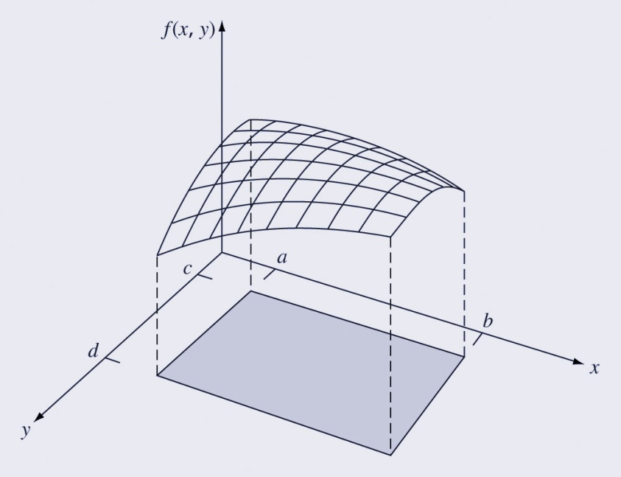
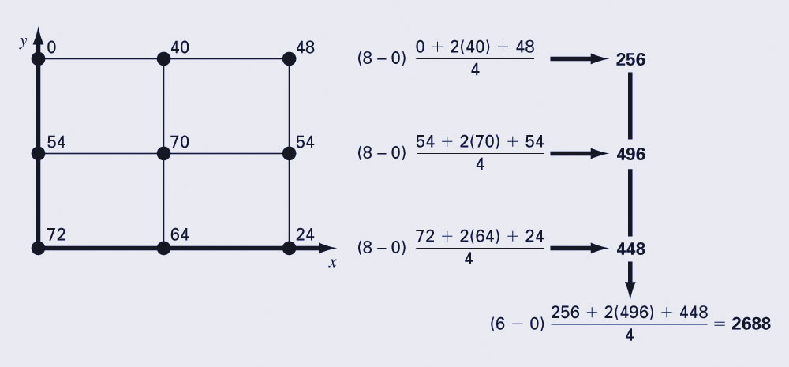
Multiple Integrals
Multiple integrals can be determined numerically by first integrating in one dimension, then a second, and so on for all dimensions of the problem.

